Slide 1

Network Models
Protocol Architectures
Chapter 2

Slide 2
Objectives
Layering in communication
Protocols
Standards
Communication Layering
  OSI Model
  TCP/IP Model
Addressing

Slide 3
Layering
Task of communication broken up into layers
Communication
Task
Layer 1
Layer 2
Layer 3

Slide 4

Layers involved in sending a letter

Slide 5





Layers involving calling a friend

Slide 6
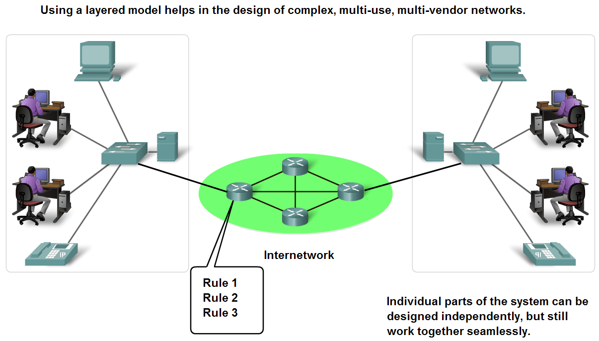
Benefits of using a layered model
To find out the fault easily.
Changes in one layer do not affect other layers.
Have defined information that they act upon.

Slide 7
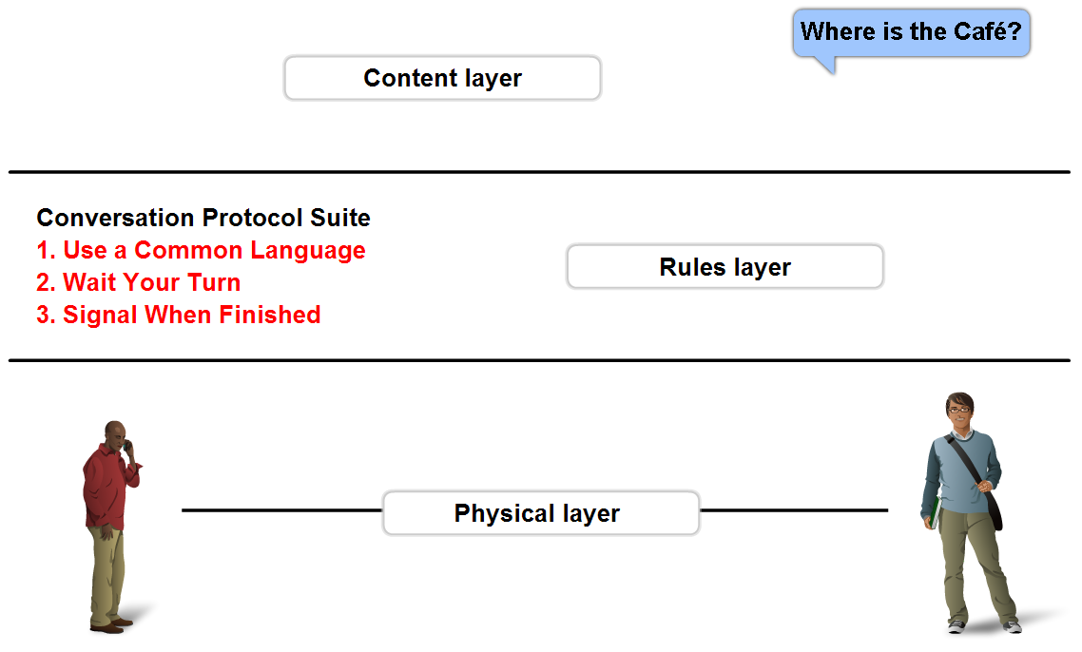
Rules that govern communications
A protocol is a set of predetermined rules.
Defines:
  What is communicated??
  How it is communicated??
  When it is communicated??

Slide 8
Protocols
Describe processes such as:
The format or structure of the message.
What?
The method by which networking devices share information about pathways with other networks.
How?
How and when error and system messages are passed between devices.
How/When?
The setup and termination of data transfer sessions.
What/When/How?

Slide 9
Protocols and Standards
Protocols
Standards
Standards Organizations
Internet Standards

Slide 10
Standards
Endorsed by the networking industry and approved by a standards organization.
Benefits:
  Create and maintain an open and competitive market.
  Ensured greater compatibility and interoperability.
Categories
De facto: Standards that have not been approved by an organized body but have been adopted as standards through widespread use
De jure: Those standards that have been legislated by an officially recognized body
Notes:
Create and maintain an open and competitive market for equipment manufacturers.
It provided vendors with a set of standards that ensured greater compatibility and interoperability among various network technologies produced by companies around the world.

Slide 11
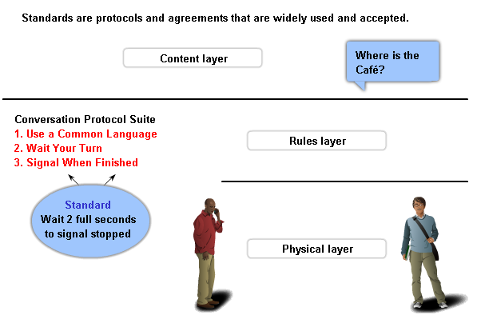
Standards and Protocols

Slide 12
Standard Organizations
International Organization for Standardization (ISO)
Institute of Electrical and Electronic Engineers (IEEE)
American National Standards Institute (ANSI)
Telecommunications Industry Association (TIA)
The Internet Engineering Task Force (IETF)
International Telecommunications Union – Telecommunication Standards Sector (ITU-T)
Notes:
Create and maintain an open and competitive market for equipment manufacturers.
It provided vendors with a set of standards that ensured greater compatibility and interoperability among various network technologies produced by companies around the world.

Slide 13
Internet Standards
Formalized regulations and specifications for the Internet by IETF.
Internet Draft
  No official status
  6 month lifetime
Request for comment (RFC)
  Upon recommendation from Internet authorities
  Different maturity levels
  Example: Internet Protocol – RFC : 791

Slide 14
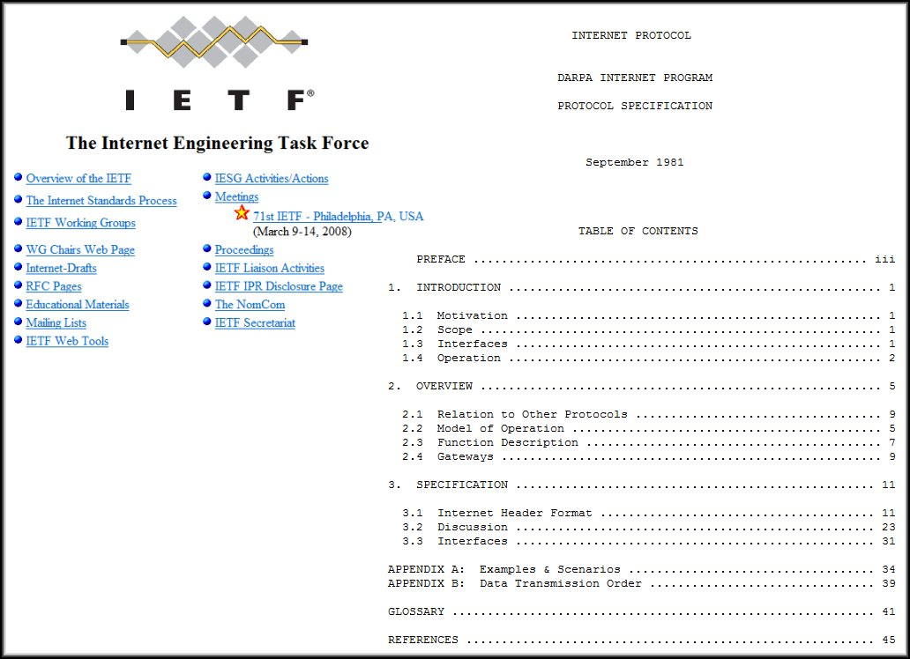
Request For Comments RFC

Slide 15
Communication Process
Layered standards:
TCP/IP Protocol Model
  Open De Facto Standard
  Governed by IETF Working
  Groups
OSI Reference model
  De Jure Standard

Slide 16
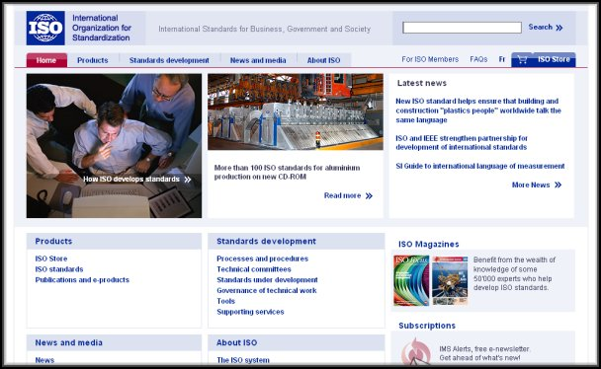
OSI Model
Open Systems Interconnection (OSI)
Developed by the International Organization for Standardization (ISO).
In 1984.

Slide 17

OSI
Seven layers
A theoretical system delivered too late!
TCP/IP is the de facto standard
Notes:
Breaks network communication into
smaller, more manageable parts.
Makes learning it easier to
understand.
Prevents changes in one layer from
affecting other layers.
Standardizes network components
to allow multiple vendor development
and support.
Allows different types of network
hardware and software to communicate
with each other.

Slide 18
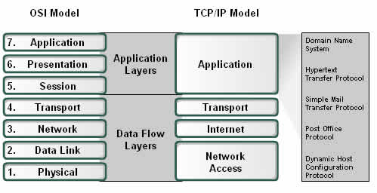
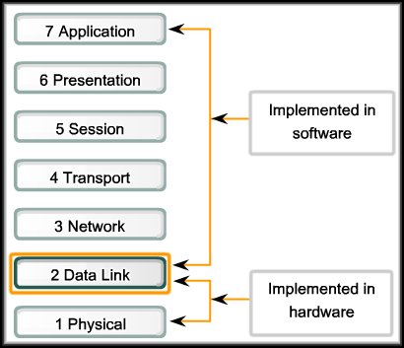
OSI & TCP/IP Models
Notes:
Breaks network communication into
smaller, more manageable parts.
Makes learning it easier to
understand.
Prevents changes in one layer from
affecting other layers.
Standardizes network components
to allow multiple vendor development
and support.
Allows different types of network
hardware and software to communicate
with each other.

Slide 19

Note
ISO is the organization.
OSI is the model.

Slide 20
OSI Model- 7 Layers
Layers |  | CISCO
7 | Application | All
6 | Presentation | People
5 | Session | Seem
4 | Transport | To
3 | Network | Need
2 | Data Link | Data
1 | Physical | Processing
Primary concern: Communications between applications
Primary concern: Moving raw data cross the network

Slide 21

An exchange using the OSI model

Slide 22
APPLICATION LAYER
2.#

Slide 23
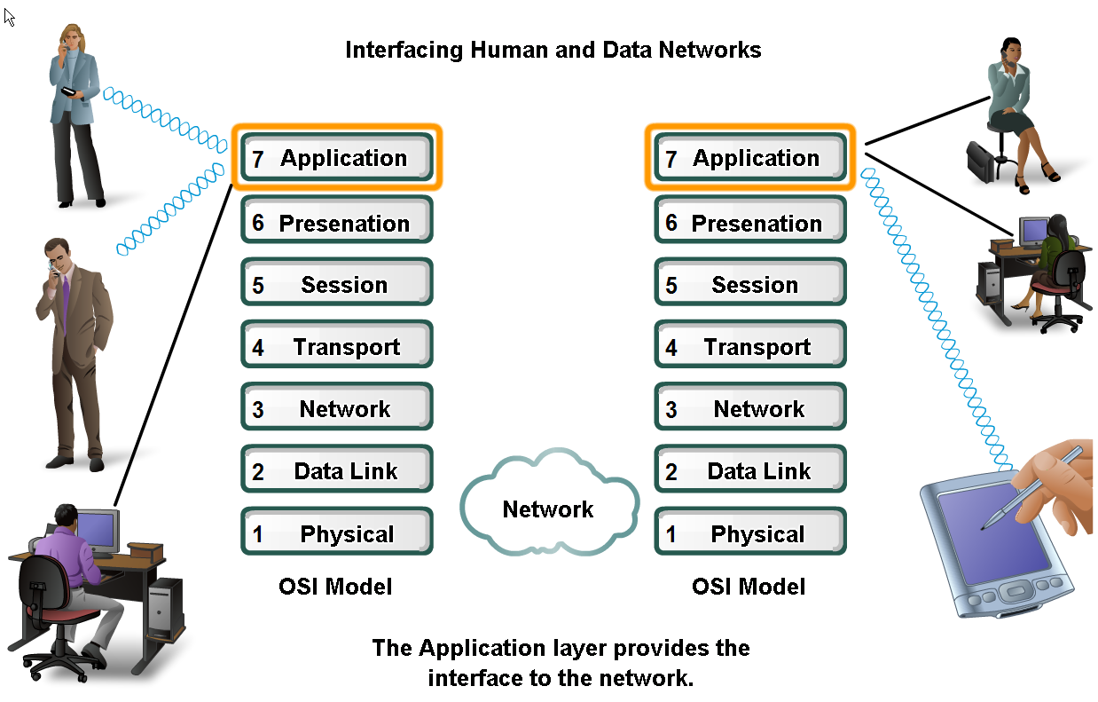
Applications
The Interface Between Human and Data Networks
Responsible for providing services to the user.
Notes:
It provides the interface between the applications we use to communicate and the underlying network over which our messages are transmitted.

Slide 24
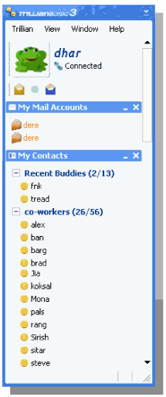
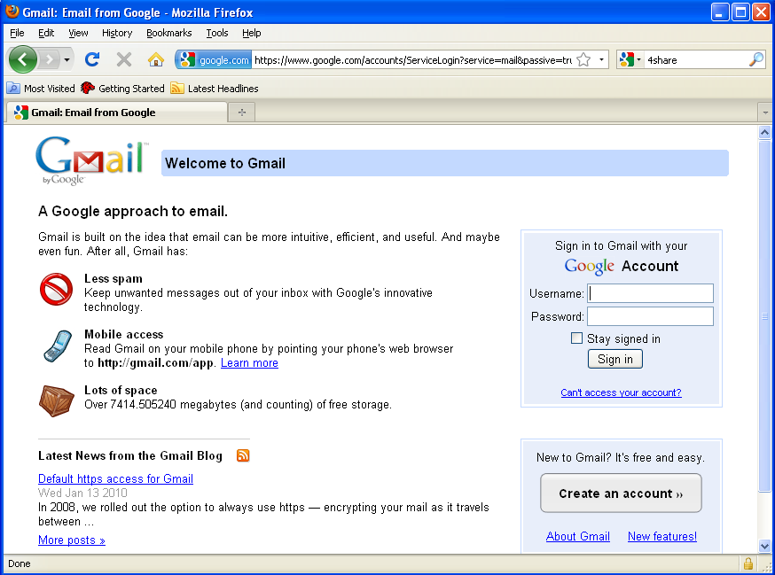
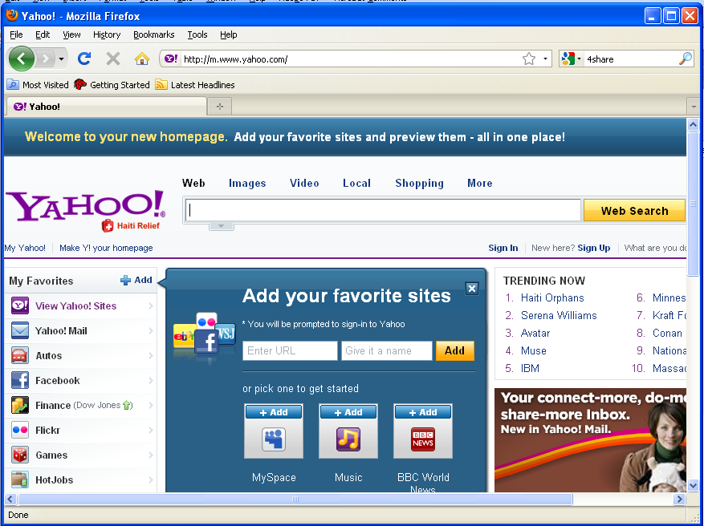
Applications in Application layer
Web Page
Email
Instant messaging

Slide 25
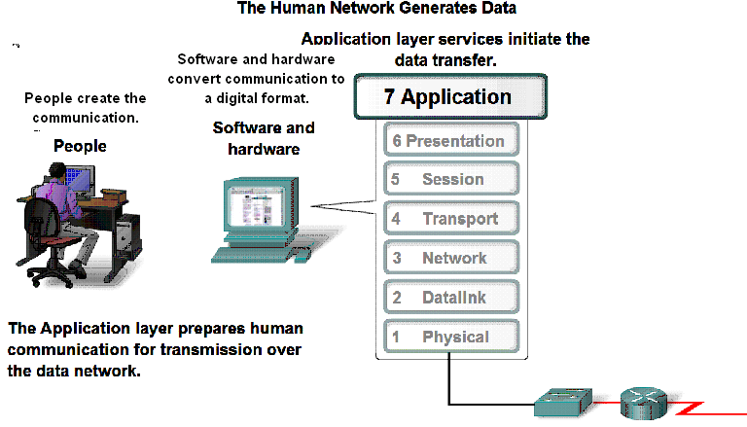
Application Layer

Slide 26

Applications in Application layer
Web Page
Email
Instant messaging
Header
H7
Data
To Presentation Layer

Slide 27
Application layer
Web Page
Email
Instant messaging
Header
H7
Data
From Presentation Layer

Slide 28
Application Layer
Examples of Protocols
DNS
HTTP
SMTP
POP
DHCP
Notes:
Application layer protocols are used to exchange data between programs running on the source and destination hosts.
There are many Application layer protocols and new protocols are always being developed

Slide 29
PRESENTATION LAYER
2.#

Slide 30

Presentation layer
The presentation layer is responsible for translation, compression, and encryption.

Slide 31
Presentation Layer
3 primary functions:
  Coding and conversion
  Compression of the data
  Encryption of the data
Presentation layer implementations are not typically associated with a particular protocol stack.

Slide 32
SESSION LAYER
2.#

Slide 33

Session layer
The session layer is responsible for dialog
control and synchronization.

Slide 34
Session Layer
It handles the exchange of information
  to initiate dialogs,
  keep them active, and
  to restart sessions that are disrupted or idle for a long period of time
Most applications, like web browsers or e-mail clients, incorporate functionality of the OSI layers 5, 6 and 7.

Slide 35
TRANSPORT LAYER
2.#

Slide 36

Transport layer
The transport layer is responsible for the delivery
of a message from one process to another.

Slide 37
Functions– Transport Layer
Segmentation and Reassembly
Adds Port Address and Sequence Number.
Connection Control
Flow and Error Control
Multiplexing
Transport Layer PDU is called Segments.
Common Protocol used in Transport Layer is TCP

Slide 38

Transport layer
Segments data received from application layer into small parts.
Transport Layer Protocol Data Unit is called Segments.

Slide 39
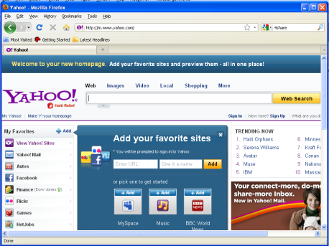
Function: Segmentation
A1
A2
Data from Application layer
1
Segments into small parts
Received by Transport Layer
2
Add a number to identify the application.
1
2
3
3
A1
A1
A1
Add a number sequence the segmented parts.

Slide 40
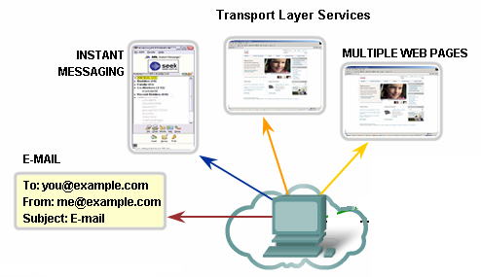
Identifying Different Applications
Port Numbers

Slide 41
Port Address
To define multiple processes running in a computer.
16-bit in length
80
A 16-bit port address represented
as one single number.

Slide 42
Function: Connection Control
Are you up?
Yes
Data

Slide 43
Function: Flow Control
Host B has too many packets to process.
Buffer to store incoming packets overflows
Data
Please send less packets.
Host A
Host B

Slide 44
Function: Error Control
1
I have 1&3, where is 2?
3
Data
Please send packet 2.
X
Lost in transition
Host A
Host B

Slide 45
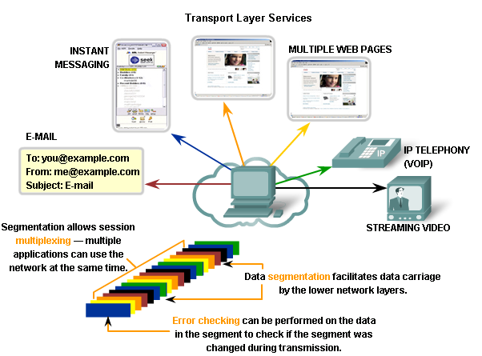
Functions– Multiplexing

Slide 46
NETWORK LAYER
2.#

Slide 47

Network layer
The network layer is responsible for the delivery of
individual packets from the source host to the destination host.

Slide 48
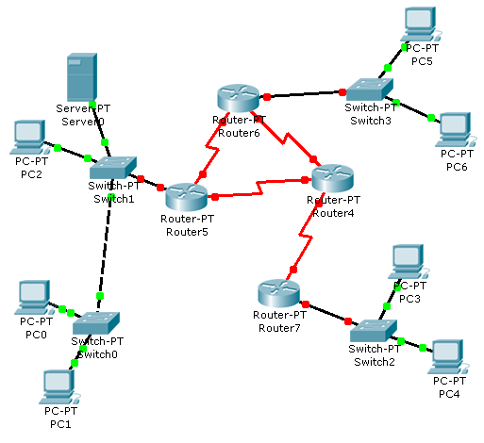
Example
LAN 2
?
?
LAN 1
?
?
Interconnections
LAN 3
Receiver
Sender

Slide 49

Source-to-destination delivery
Functions :
  Adds an address to identify sender and receiver hosts.
  Decides which path to take.
Adds Logical Addressing
Routing
A
F

Slide 50
Source-to-destination delivery
Network Layer PDU is called Packets.
Common Network layer Protocol is called Internet Protocol (IP)

Slide 51
Logical Addresses :: IP Address
Universal address, each host uniquely defined.
32-bit address also known as IP Address.
Independent of underlying physical networks.
192.168.10.1
32 bits written in dotted decimal notation. Each decimal represented by 8 bits.

Slide 52
DATALINK LAYER
2.#

Slide 53

Data link layer
The data link layer is responsible for moving
frames from one hop (node) to the next.

Slide 54
Functions-Data Link Layer
Framing.
Physical Addressing
Flow Control
Error Control
Access Control
Data Link Layer PDU is called Frames.
Data Link Layer Protocol varies.

Slide 55
Functions : Framing
From Network Layer
Header
H2
Data
Trailer
T2
Data Link Layer
To Physical Layer

Slide 56

Hop-to-hop delivery

Slide 57
Physical Address : MAC Address
Every interface/port has an unique identifying number.
Given by manufacturer.
48 bits long, represented by 12 hexadecimal digits.
07:01:02:01:2C:4B
Also known as MAC (Media Access Control) Address.

Slide 58

Addressing
Assume:
IP Addresses – Alphabets
MAC Addresses - Numbers
22
21
M
A
F/22
D/13
G/31
32
31
M
A
E/21
H/32
B/12
42
M
A
41
IP address
MAC address
IP address
N/41
MAC address
M/42
A/11
13
11
M
A
Receiver
Sender
D S D S

Slide 59

Addressing

Slide 60
Addressing-Within the same network
Assume:
IP Addresses – Alphabets
MAC Addresses - Numbers
E/15
D/14
C/13
Receiver
B/12
A/11
14
11
D
A
Sender

Slide 61
PHYSICAL LAYER
2.#

Slide 62

Physical layer
The physical layer is responsible for movements of
individual bits from one hop (node) to the next.

Slide 63
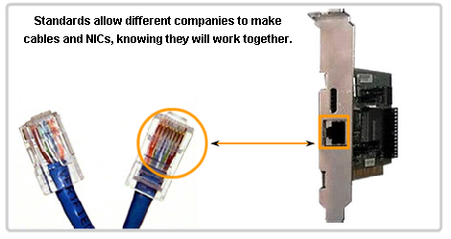
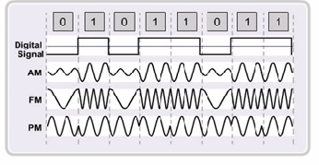
Functions-Physical Layer
Physical Characteristics of interfaces and medium.
Representation of bits
Data Rate
Synchronization of bits

Slide 64
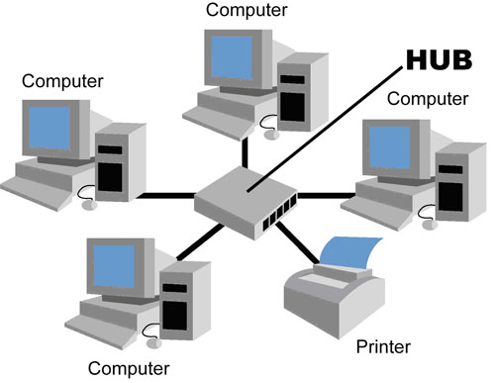
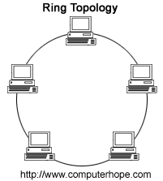
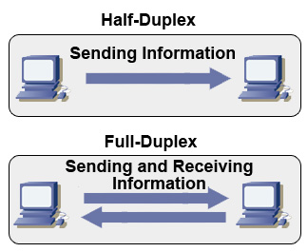
Functions-Physical Layer
Physical Topology
  Bus
  Ring etc
Transmission Modes
  Simplex
  Half Duplex
  Full Duplex

Slide 65

Summary of OSI Layers

Slide 66
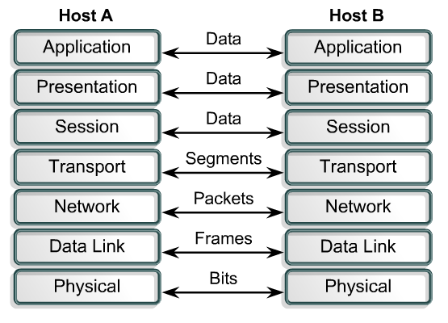
Summary
PDUs
Encapsulation
Headers and trailers

Slide 67
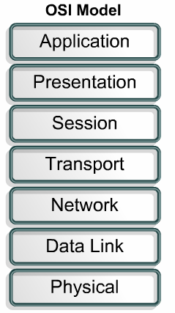
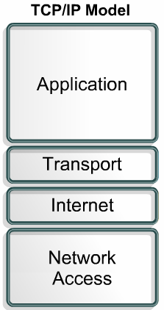
TCP/IP
Developed by the US Defense Advanced Research Project Agency (DARPA) for its packet switched network (ARPANET)
Used by the global Internet.
De Facto Standard

Slide 68
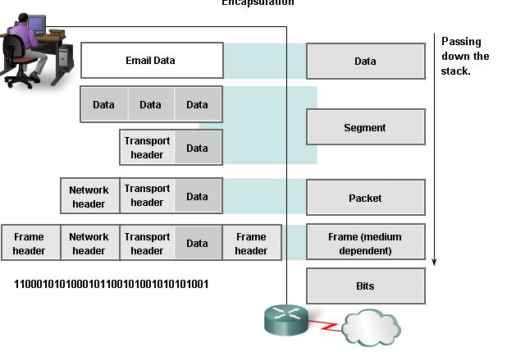
TCP/IP Encapsulation

Slide 69

TCP/IP and OSI model

Slide 70

Addressing Summary
Four levels of addresses are used in an internet employing the TCP/IP protocols

Slide 71

Relationship of layers and addresses in TCP/IP
IP Address
MAC Address

Slide 72
Specific Addresses
Applications having user friendly addresses.
Email addresses or URLs.
  john@gmail.com or www.bracu.ac.bd
These are converted into corresponding port and logical addresses by the sending computer.

Slide 73
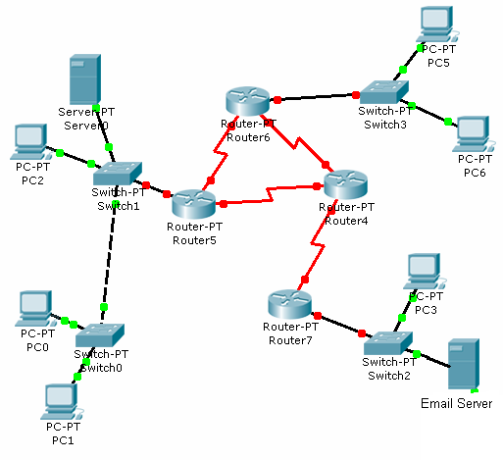

Addressing Review
13
11
M
A
k
a
Assume:
IP Addresses – Capital Alphabets
MAC Addresses – Numbers
Port Numbers- Small Alphabets
D S D S D S
F/22
D/13
G/31
E/21
B/12
H/32
IP address
N/41
Email
k
MAC address
A/11
Email
a
Web
c
M/42
Receiver
Sender

Slide 74

Addressing Review
Although physical addresses change from hop to hop, logical and port addresses remain the same from the source to destination.

Slide 75
END
2.#

